Slide 1




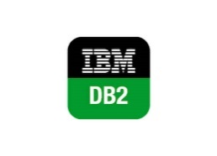

6. Mulesoft will construct the reponse in csv
7. EFTP FOLDER
<Network path>
7. EXTRACT AND LOAD THE DATA IN DDH_STG
<CDC>
5. Response
IN Json Format
7. READ THE
FILE
4. Request
Initiate Request with Essential Parameters
Job will be scheduled with in Mulesoft(Daily)
URL & Parameter will be configured in Mulesoft
Action items:
EFTP Path <Network path>
Confirm Access for the Network Path ?
Devonway Request parameter
Mulesoft can drop file in EFTP path ?
Confirm Retention policy the files in EFTP Shared path

